Slide 1
Project Presentation – CM2003 David Dashti Filip Söderquist

Slide 2
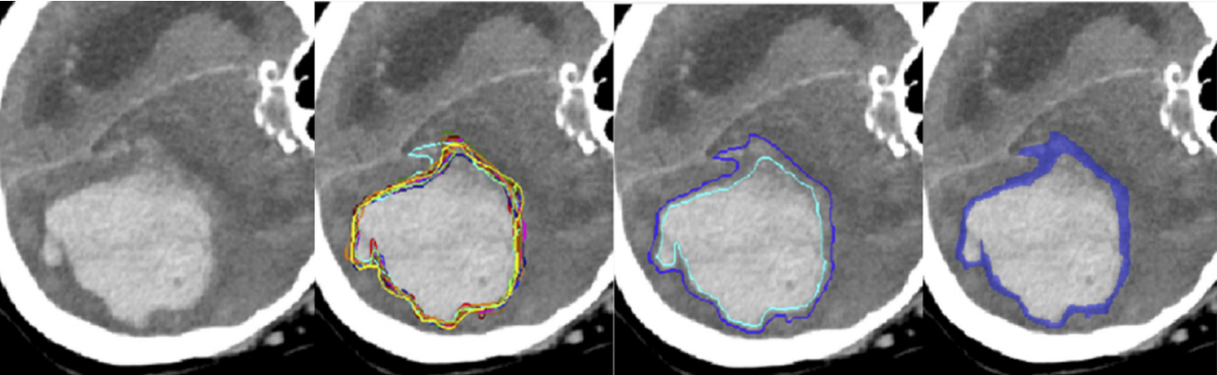
The challenge - QUBIQ
Quantification of Uncertainties in Biomedical Image Quantification Challenge

Slide 3
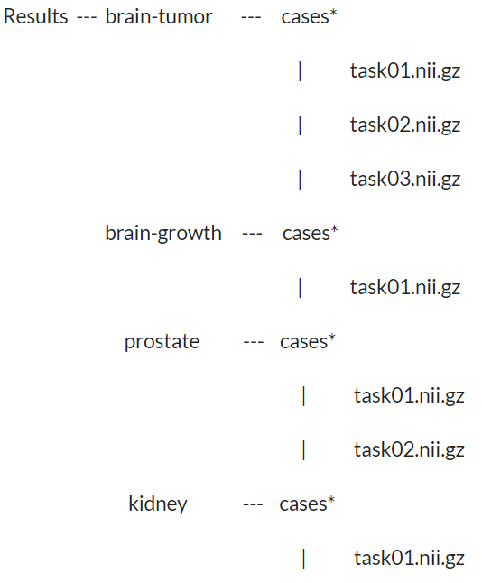
Data
( 3 masks / task )
( 7 masks )
( 6 masks / task )
( 3 masks )

Slide 4
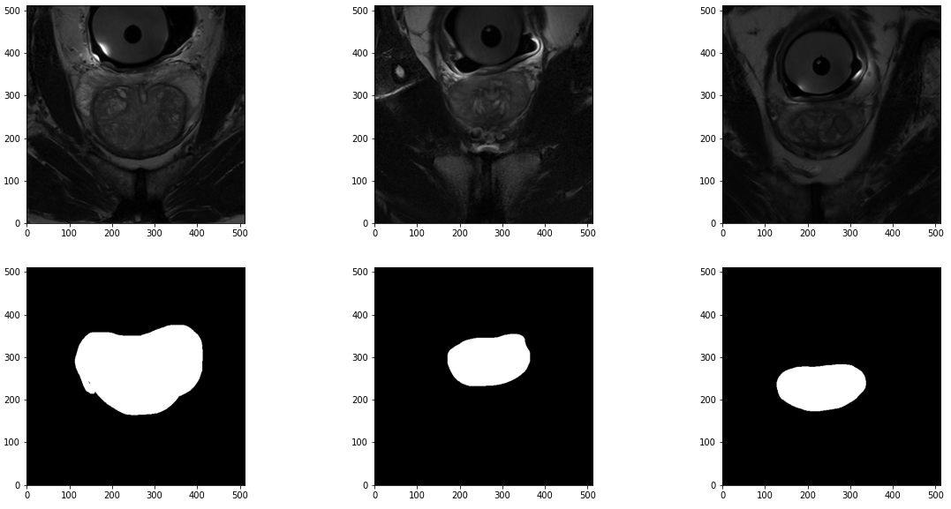
Data – Examples

Slide 5
Data split
Original Challenge
Adjusted Challenge
Data | Train. | Val. | Test
Tumor | 28 | 4 | 8
Growth | 34 | 5 | 10
Prostate | 48 | 7 | 13
Kidney | 20 | 4 | 4
Data | Train. | Val. | Test
Tumor | 24 | 4 | 4
Growth | 29 | 5 | 5
Prostate | 41 | 7 | 7
Kidney | 16 | 4 | 4
Split: ~ 70 / 10 / 20
Split: ~ 75 / 12.5 / 12.5

Slide 6
The task in detail
Task
Segment the given binary structures and predict the distribution of the experts' labels by returning one mask with continuous values in between 0 and 1, that is supposed to reproduce the cumulated segmentations of the experts. Predictions and continuous ground truth labels are compared by thresholding the continuous labels at predefined thresholds and calculating the volumetric overlap of the resulting binary volumes using Dice score (the continuous ground truth labels are obtained by averaging multiple experts' annotations). To this end, ground truth and prediction are binarized at ten probability levels (that are 0.1, 0.2, ..., 0.8, 0.9). Dice scores for all thresholds will be averaged. Dice scores will be averaged across all tasks and all image data sets.

Slide 7
How we approached this problem
Predictions
We trained one network for each expert. I.e. for brain-growth we trained 7 networks as we had 7 expert segmentations for each image.
Then we created an ensemble by averaging the predictions of these networks. Thus, creating a continuous mask.
After that we binarized the continuous masks, at the 9 chosen threshold levels (0.1, 0.2, …, 0.9), producing 9 binarized masks.
The expert masks
The comparison were done in two steps:
Averaging of all the expert masks to create a continuous mask.
This continuous mask was then binarized into 9 different masks using the same threshold levels as the prediction masks.
Finally, these were compared with the prediction masks for each threshold level and the average Dice value is returned.

Slide 8
Data pre-processing
Reshaping
U – Net requires symmetrical images, with size of factors of 2. We performed zero-padding on the data to increase the image size or removed data from the edges to decrease the image size.
Data augmentation
Since we had a small amount of data, we leveraged data augmentation in order to decrease the risk of the network overfitting. The augmentations we used were:
Random rotation by 10 degrees
Random height and width shift with range 0.1
Random horizontal flip (except kidney, since all masks were located to the right)
Windowing
For the kidney dataset we found intensity windowing to be essential for good performance. Intensity windowing could only be applied to kidney since they were the only CT images.

Slide 9
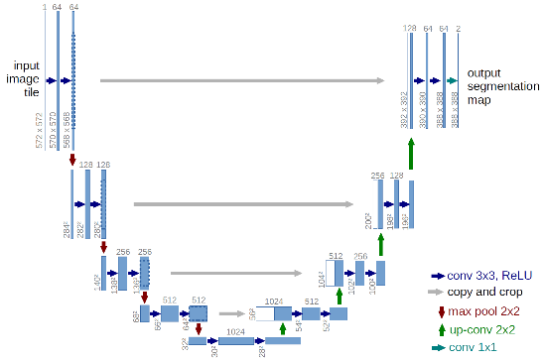
The different architectures
The core of our architecture is that we are using an ensemble of networks to create the continuous prediction masks by means of averaging the prediction of each individual network
Architecture of the networks within the ensemble
We used U-Net as a starting point
Deep U - Net
Dropout / Spatial Dropout
LSTM

Slide 10
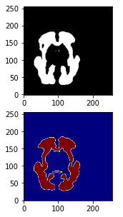
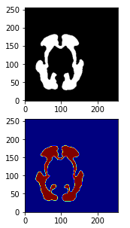
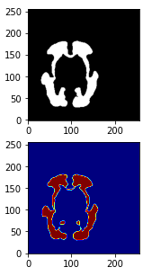
Example – Brain Growth
Threshold: 0.1 0.5 0.9

Slide 11
Results – Brain Growth
Test img 1 Test img 2 Test img 3 Test img 4 Test img 5
[ 0.93583164 0.91756011 0.92664515 0.92461265 0.91743671 ] 0.1
[ 0.93409206 0.92813544 0.93756521 0.9487477 0.92060032 ] 0.2
[ 0.91498722 0.92744047 0.93498344 0.95139697 0.91743202 ] 0.3
[ 0.91603053 0.92853073 0.93747431 0.94813614 0.91683123 ] 0.4
[ 0.89932147 0.91621787 0.93510343 0.94994179 0.9079803 ] 0.5
[ 0.86764556 0.89445518 0.93347302 0.94487801 0.89759553 ] 0.6
[ 0.87227964 0.89383016 0.93773622 0.94386694 0.89657061 ] 0.7
[ 0.84381791 0.84345653 0.921047 0.9337181 0.8686314 ] 0.8
[ 0.72017241 0.75427952 0.8970039 0.86904251 0.72462609 ] 0.9
Average: 0.9033591377190376

Slide 12
Results – Brain Tumor
Task 1
[ 0.80333654 0.96819294 0.94560937 0.92486772 ] [ 0.79793748 0.966363 0.94403582 0.92378372 ] [ 0.79248948 0.96296296 0.94284799 0.92225898 ] [ 0.65513078 0.95234577 0.90991726 0.93136381 ] [ 0.65050505 0.94924046 0.90762583 0.93061224 ] [ 0.64448052 0.94572491 0.90666667 0.92787724 ] [ 0.56238361 0.89093825 0.82708934 0.91930598 ] [ 0.55726975 0.88557615 0.82485876 0.91747171 ] [ 0.55305164 0.88484848 0.82399369 0.91652847 ] Average: 0.8547081212485439
Task 2
[ 0.93387653 0.95982469 0.90964348 0.94965705 ] [ 0.93220339 0.95715855 0.90667919 0.94758692 ] [ 0.92778303 0.95476278 0.90264026 0.9452037 ] [ 0.86197183 0.94879518 0.63844702 0.96122779 ] [ 0.85762904 0.95049505 0.63254806 0.95824889 ] [ 0.85616438 0.94793262 0.62602069 0.95528455 ] [ 0.39443155 0.92740047 0.36479052 0.53393665 ] [ 0.37220259 0.92941176 0.35519591 0.52830189 ] [ 0.35866983 0.92781065 0.3470437 0.55172414 ] Average: 0.7781306762803059
Task 3
[ 0.72067039 0.89373297 0.71050521 0.95891537 ]
[ 0.70185449 0.89931034 0.69480519 0.95720165 ]
[ 0.68596237 0.89693593 0.67763158 0.95332507 ]
[ 0.72621359 0.91780822 0.501228 5 0.95283843 ]
[ 0.71400394 0.91854419 0.488228 0.95096322 ]
[ 0.71146245 0.92146597 0.45627376 0.94958352 ]
[ 0.71428571 0.91242363 0.26691729 0.90846116 ]
[ 0.71321696 0.90983607 0.22393822 0.90293678 ]
[ 0.71 0.90721649 0.21052632 0.89955022 ] Average: 0.7566325900087255

Slide 13
Results – Kidney
Test img 1 Test img 2 Test img 3 Test img 4
[ 0.9639128 0.95709282 0.73751274 0.64533177 ] 0.1
[ 0.96252755 0.95736094 0.73765037 0.64424779 ] 0.2
[ 0.96129746 0.95655233 0.73788905 0.6441348 ] 0.3
[ 0.97769254 0.96540763 0.96364686 0.96430213 ] 0.4
[ 0.97591581 0.96595705 0.96262007 0.96375921 ] 0.5
[ 0.97506083 0.96706192 0.96206937 0.96364757 ] 0.6
[ 0.97238638 0.96049184 0.95776699 0.96033948 ] 0.7
[ 0.9712929 0.96024279 0.95580178 0.95833333 ] 0.8
[ 0.97014925 0.96012986 0.95396263 0.95819618 ] 0.9
Average: 0.9181040223071035

Slide 14
Results – Prostate
Task 1
[ 0.89154465 0.94723236 0.81266661 0.89447263 0.92829861 0.88936978 0.78054278 ] [ 0.93964567 0.96457946 0.90959612 0.95527939 0.95736155 0.96386504 0.94889747 ] [ 0.95871993 0.96987709 0.92675734 0.96313586 0.95662669 0.96633685 0.94807999 ] [ 0.96242351 0.959739 0.92642392 0.96279135 0.95650054 0.96344419 0.87097812 ] [ 0.96890844 0.96544713 0.93120324 0.96842337 0.95631272 0.95907846 0.86629111 ] [ 0.96162291 0.96799011 0.92245602 0.97398068 0.96332147 0.96358298 0.84760776 ] [ 0.95710134 0.9615261 0.89936413 0.96957023 0.93307398 0.95144645 0.82347221 ] [ 0.96334524 0.96689257 0.90343472 0.97419719 0.92715897 0.94723186 0.80882858 ] [ 0.94926557 0.94512048 0.89762388 0.94413624 0.90673369 0.92561418 0.71532633 ] Average: 0.9295536010084651
Task 2
[ 0.75798471 0.95817479 0.77040663 0.87990698 0.87248782 0.88249926 0.7866023 ] [ 0.90858806 0.9789827 0.93387194 0.94092756 0.93291905 0.94537668 0.93718464 ] [ 0.90777693 0.97953513 0.93340709 0.9413741 0.93209266 0.94416739 0.93780369 ] [ 0.91865751 0.96592953 0.93827918 0.94052773 0.92996455 0.94208232 0.93552092 ] [ 0.91433601 0.96733447 0.93654994 0.93859891 0.92659903 0.93875028 0.93083976 ] [ 0.90950532 0.96341247 0.93122939 0.94107498 0.89879499 0.93641381 0.93199513 ] [ 0.91287346 0.94477377 0.90148465 0.91467227 0.85209127 0.90066225 0.92044135 ] [ 0.91085759 0.94460246 0.90073007 0.91276032 0.85053363 0.89753014 0.92135582 ] [ 0.90852889 0.63265835 0.8132334 0.87916822 0.81273796 0.84976621 0.89232237 ] Average: 0.9074960445007931

Slide 15
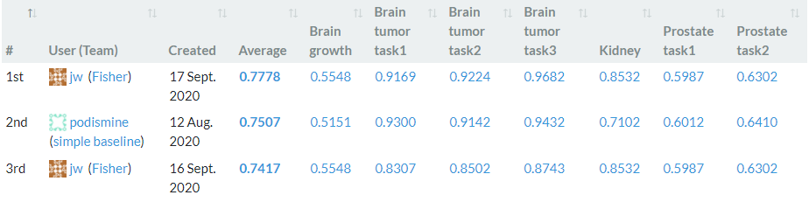
Evaluation
Our scores:
0.864 | 0.9034 | 0.8547 | 0.7781 | 0.7566 | 0.9181 | 0.9296 | 0.9075

Slide 16
Thank you for listening! Questions?
Discussion

